Slide 1


FIH workshop _ Final agenda
Chasing optimum First-In-Human (FIH) dose:
Welcome to reality !
23.05.2025
Wojo Montparnasse, Paris 14^{ieme}

Slide 2





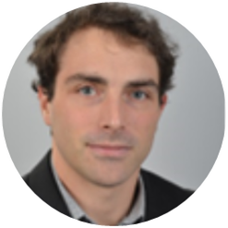
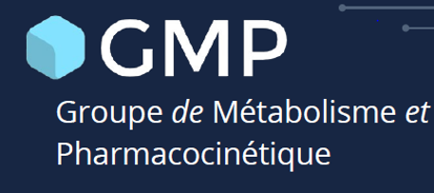

FIH Workshop
Agenda
9h00 – 9h15 Welcome Coffee
Morning session
9h15-9h30 | Introduction | Round table
9h30-10h30 | Antoine Deslandes Sanofi | Getting the FIH dose right : how to transform preclinical knowledge into clinical applications
10h30-12h30 | François Bouzom Simulations Plus | Physiologically Based PharmacoKinetics (PBPK) modelling to support the First In Human (FIH) studies of small molecules
Chasing optimum First-In-Human (FIH) dose
Welcome to reality
12h30 – 13h30 On-site buffet Lunch
Afternoon session
13h45-14h00 | Q&A morning session
14h00-15h00 | Martin Bergstrand Pharmetheus | Working with Probability of Pharmacological Success (PoPS) to inform FIH studies
15h00-17h00 | Glenn Gauderat Servier | Knowledge sharing on specific challenges for FIH dose predictions
Friday 23rd of May 2025
Wojo Montparnasse, Paris 14^{ieme}
^{Salle coin Gourmet}
17h00 – 17h15 Wrap-up | survey

Slide 3
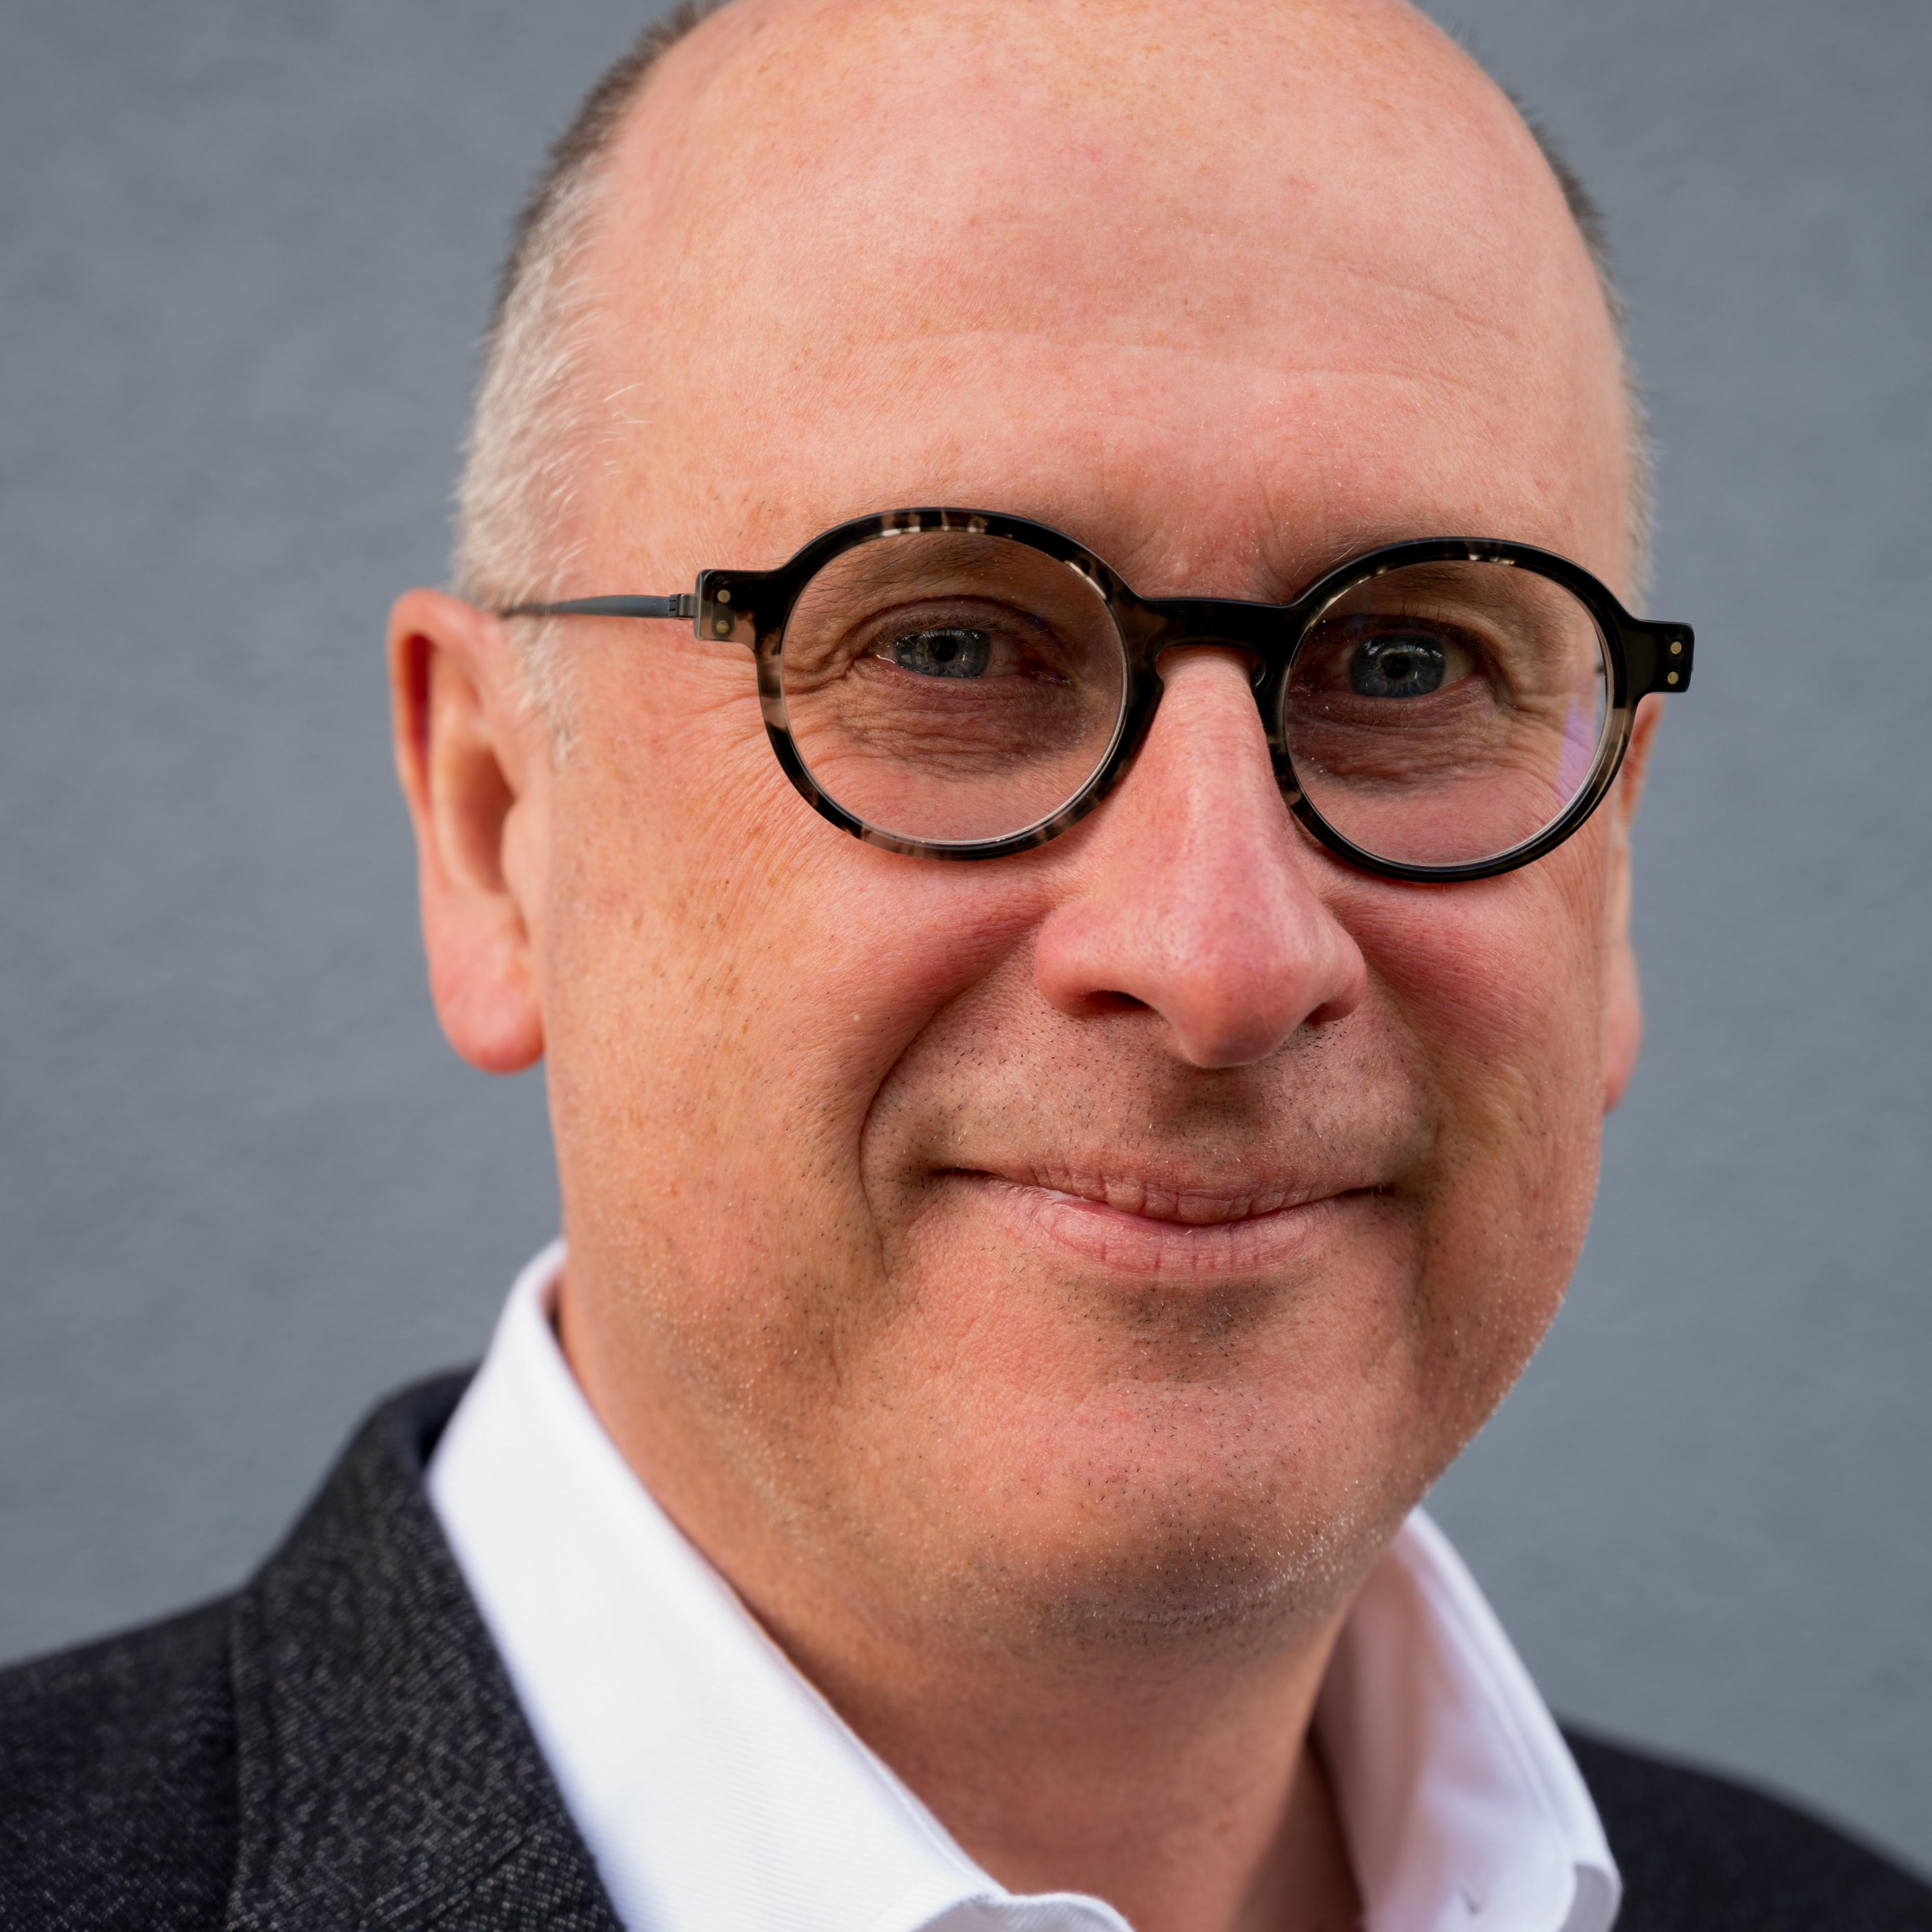

Global Scientific Advisor PKDM - Devices PK
•
TMED Pharmacokinetics Dynamics and Metabolism
Global Scientific Advisor PKDM - Devices PK
•
TMED Pharmacokinetics Dynamics and Metabolism
FIH Workshop
Chasing optimum First-In-Human (FIH) dose
Welcome to reality !
Antoine Deslandes
Sanofi, Translational Medicine Unit, Quantitative Pharmacology
Vitry S/Seine, France
Getting the FIH dose right : how to transform preclinical
knowledge into clinical applications
First-in-human (FIH) trials serve as critical milestones, bridging the gap between preclinical studies and subsequent clinical development phases. These trials primarily aim to establish a safe dose range for further clinical development. Regulatory guidelines outline a structured framework that includes: characterization of pharmacological and toxicological effects in vitro and in animal models, prediction of human exposure, anticipation of human response, and mitigation of potential risks from unknowns and uncertainties. Consequently, selecting an FIH dose necessitates the integration of data from multiple disciplines. Despite the differences between biologics (such as monoclonal antibodies) and small molecules, the fundamental principles for determining an FIH dose remain similar. These principles can be categorized into model-independent and model-based approaches
Antoine graduated in Pharmacy, then received his PhD in Clinical Pharmacology from the Paris University, complemented later with Masters in “Modelling and Statistics” and “Immunology and Biotherapy”.
At Sanofi, as a Biotherapeutics Scientific Expert, Antoine provides scientific and strategic leadership in the areas of pharmacokinetics (PK), pharmacodynamics (PD), and translational pharmacology for biotherapeutics.

Slide 4


FIH Workshop
Chasing optimum First-In-Human (FIH) dose
Welcome to reality !
François Bouzom Director | PBPK | Simulations Plus
Physiologically Based PharmacoKinetics (PBPK) modelling to support the First In Human (FIH) studies of small molecules
François Bouzom is currently director of the Simulation Studies Team at Simulations Plus Inc., where he leads and mentors scientists and provides consulting services for the pharmaceutical industry.
During more than 30 years, François has worked in the pharmaceutical industry to support drug development focusing on Pharmacokinetics and drug development. Through his different positions, he has built a strong knowledge of every skill linked to Pharmacokinetics, from non-clinical to clinical and from bioanalysis to modelling.
François has started working on PBPK modelling in 2000. From that time, he has never stopped working in that area, making people aware of its unique value, expanding its applications, and still having time to teach students.
In this section of the workshop, the attendees will learn about the value of the PBPK approach to support FIH studies using decision trees to better define the absorption, the distribution, the metabolism and the excretion of the drugs in development.
The strategy will be illustrated with a couple of case studies.
Finally, a hands-on session will allow each attendee to apply the strategy to a case study.

Slide 5


FIH Workshop
Chasing optimum First-In-Human (FIH) dose:
Welcome to reality !
Martin Bergstrand
Working with Probability of Pharmacological Success (PoPS) to inform FIH studies
Principal Consultant and MIDD platform scientific lead at Pharmetheus
The Probability of Pharmacological Success, or PoPS, is a metric to inform early-stage drug development decisions based on benefit and risk data available at the time. In a FIH setting PoPS can for example be used to: (1) prioritize between different candidate assets to decide which one to bring into clinic and (2) select the planned dose range to study in FIH studies.
The PoPS approach was initially introduced by Dr. Chao Chen and colleagues [1-3]. The approach leverages information about pharmacokinetics (PK), exposure–response (ER) relationships for desired as well as undesired pharmacology (efficacy and safety). In addition, it defines targets for the relevant endpoints (e.g. target engagement and risk of exposure above the no observed adverse effect level). At the stage of FIH the available PKPD information about is usually primarily based on in vitro and/or animal studies. These are by nature associated with considerable uncertainty. PoPS allows to account for this uncertainty in a quantitative manner, and to propagate it them into an overall probability to meet a multi criteria definition of pharmacological success.
Pharmetheus has extended the original PoPS concept and implemented a template workflow to facilitate efficient and reproducible applications [4]. The template workflow was developed for RStudio and Quarto to allow for a combination of ease of use for simple routine applications and more advanced custom applications.
The presentation will introduce the basic idea of PoPS as well as the template workflow in application to a FIH case-study. For confidentiality reasons this will be a simulated hypothetical example inspired by real case studies. It will also discuss the importance of systematically accounting for uncertainties in planning for FIH studies and the value of a workflow that can be easily updated with emerging information during early drug development.
References:
Chen C. Opportunities and pitfalls in clinical proof-of-concept: principles and examples. Drug Discov Today. 2018 Apr;23(4):776-787. doi: 10.1016/j.drudis.2018.01.045. Epub 2018 Feb 3. PMID: 29406264.
Zhou X, Graff O, Chen C. Quantifying the probability of pharmacological success to inform compound progression decisions. PLoS 12;15(10):e0240234.
2. Chen C, Zhou X, Lavezzi SM, Arshad U, Sharma R. Concept and application of the probability of pharmacological success (PoPS) as in drug development: a position paper. J TranslMed. 2023 Jan 11;21(1):17
Leirens Q, Ibrahim M.A, Bergstrand M. A workflow for comparing drug candidates based on Probability of Pharmacological Success (PoPS). Poster GMP Symposium 2024.
Martin obtained his PhD in Pharmacometrics from Uppsala University. He has 20+ years of drug development experience in areas such as metabolic disorders, autoimmune disease, infectious disease, hematological disorders etc. In 2012 Martin co-founded the consulting company Pharmetheus AB. In the consultant role he has been engaged as strategic advisor on behalf of multiple clients and acted as the main responsible consultant for 50+ pharmacometric data analysis projects on behalf of more than 20 different clients. The projects have ranged from pre-clinical translational projects to submission ready large-scale phase III PKPD analysis. These analyses have among other things contributed to 6+ successful NDA filings and 5+ FIH studies.

Slide 6


FIH Workshop
Chasing optimum First-In-Human (FIH) dose
Welcome to reality !
Knowledge sharing on specific challenges for FIH dose predictions
Glenn Gauderat Servier
This session will be dedicated to informal discussions around technical and strategic topics related to FIH dose predictions. From dose selection rationales to translational PK/PD methods.
Each topic will be introduced by a dedicated speaker, then the topic will be discussed with attendees to share practices and viewpoints.
Prediction of antibody exposure at site of action :
healthy tissues and tumors
hFcRn mice models for FIH PK predictions
Prediction of subcutaneous bioavailability for antibodies
FIH estimation for 3 case studies & retrospective analysis from clinic
Glenn Gauderat is a Pharmacometrician at Servier. Specializing in antibody-based therapeutics within Servier’s translational pharmacometric department, Glenn provides PK/PD support to projects across multiple therapeutic areas from research to early clinical phases. He holds a master’s degree in biotechnology and a PhD in pharmacokinetics.

