Slide 1
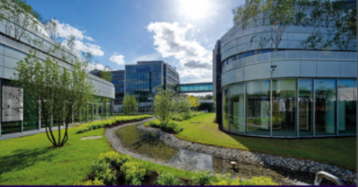
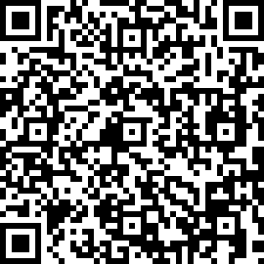
2025 GMP Symposium
Pioneering Advances in Pharmacokinetics
DAY 1
DAY 2
Replacing and refining in vivo PK experiments
VICT3R Consortium M. Dupré |Sanofi
KEYNOTE speaker
P. Moingeon | Paris Saclay U
Intelligent drugs: how AI is transforming healthcare
New modalities of drug administration S. Guerif | Sanofi – Z. Fang | Merck Healthcare KGaA Q. Nguyen | Novartis
Artificial Intelligence & Machine Learning shaping the Future of Drug Development
M. Karlsen | Sanofi – N. Canouï | Aqemia M. Boussena | COMPO CRCM, Aix-Marseille University
New biomarkers for translational studies N. Van Erp | Radboud University Medical Center
A. Delmas | Laboratoires Servier
Beyond a Covariate: Towards Sex-Based. Drug Development for Women P. Annaert - KU Leuven - E. Hansson | Pharmetheus
J. Delahousse | Gustave Roussy
15th to 17th October 2025
Students Poster Blitz
Poster Session & Cocktail
Innovations in Drug Transporters
S. Neuhoff | Certara – P. Tatrai | Solvo D. Scotcher | University of Manchester
Le Corum, 80 avenue Raspail Gentilly, France
DAY 3
Dose individualization
ONE STEP ASIDE N. Martin | Former pharmacy intern and journalist at France Culture
D. Jan Moes | University of Leiden - F Foissac | Paris Cité University - F Lemaitre | University of Rennes
“Médicaments et Philosophie”
Central nervous system and therapy
Gala diner
N. Janssen | Roche - A. Lopez-Noriega | Medincell Speaker to be confirmed
Poster Awards
Detailed agenda

